Slide 2
Ground Rules
[add your class rules here]
[add your class rules here]
[add your class rules here]
[add your class rules here]
[add your class rules here]

Slide 3
Learning Objectives
To learn about the benefits of young people’s involvement in studies that may affect their health and wellbeing, and develop understanding of consent in relation to surveys.
Learning Outcomes
By the end of the lesson I will be able to…
describe the rights of young people involved in research, including that they can choose whether to give their consent to participate
explain how data is gathered for research studies, how this can be kept private and how it might be used
evaluate the benefits and drawbacks of young people participating in research

Slide 4

Young people in research
When making decisions that affect young people, it can be helpful for decision-makers in government or local areas to
know more about what young people need and what their experiences are like.
On your own, write down answers to the following questions:
What are...
3 potential positive outcomes of involving young people in research?
2 ways young people can be treated respectfully by researchers and decision-makers?
1 question you have about involving young people in research?

Slide 5



Young people in research
Informed consent means that before someone agrees to do something, they have the right to know what it involves and what risks or benefits there are.
This helps them to make an informed decision based on what's right for them.
Informed consent is important because
it helps to protect people's rights and means they have the information they
need to make a decision, and that they aren't being pressured into something without fully understanding what's involved.
Examples of when informed consent is needed:
Taking part in a research study
Medical procedures
Sharing personal data online

Slide 6


Rights, data and research
In your group, answer the question on the sheet on your table.
After 2 minutes, move to the next table and answer the question.
Repeat until your group have answered all 6 questions.
Your group should stay with the last question you answered.
Turn over the information sheets around the room.
Use the information to add or change any responses to the question on your table.
Choose a spokesperson from your group to share a brief answer to the question you’ve been given with the class.

Slide 7
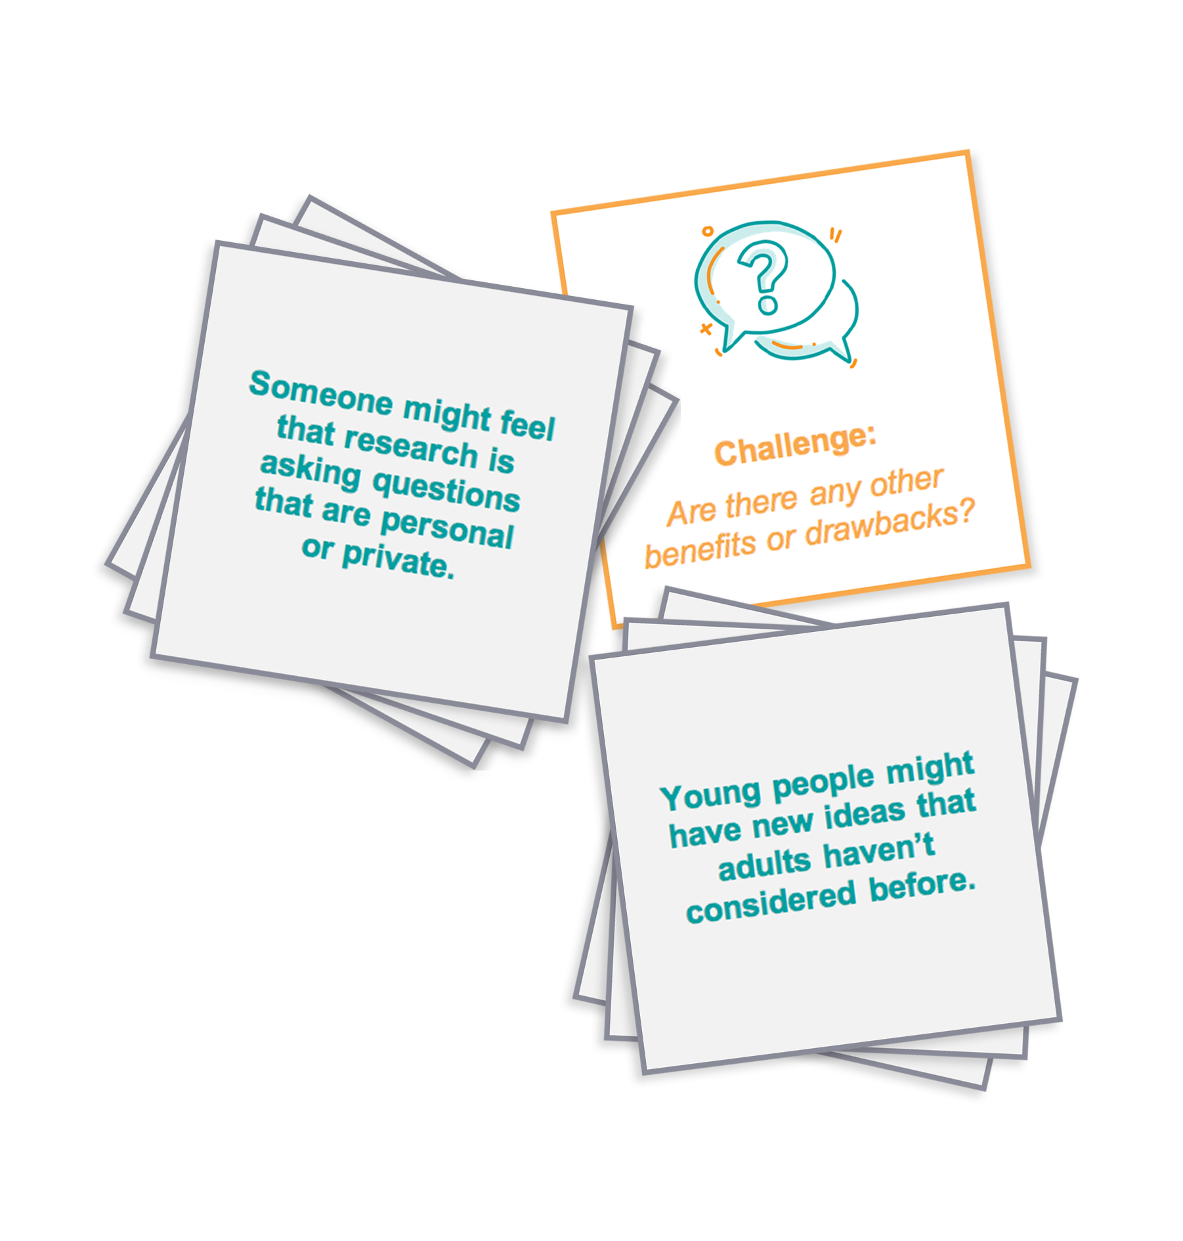

Benefits and drawback card sort
Sort the cards into two piles:
Benefits of young people taking part in research
Drawbacks of young people taking part in research
Do the benefits of young people taking
part in research outweigh the drawbacks?
Why?

Slide 8

What have we learnt?
Imagine a friend has been asked to take part in a research study but they’re not sure about it.
They’ve asked you what they should do next.
On your own, write a brief response to your friend.
Your response should...
Explain the benefits of taking part in research or anticipate the concerns your friend might have and discuss any ways researchers might try to address these concerns
Remind your friend where they can find out more information
Explain to your friend how consent is managed in research and the benefits of taking part

Slide 9

Private reflection
Has your question from the start of the lesson been answered?
If not, put your question in the anonymous question box.

Slide 10
Support
If you have queries or require further support regarding what we have learn about today, talk to:
a parent/carer
teacher
Head of Year/Form tutor
Support about alcohol, smoking, vaping and other drugs is available from:
Visit www.nhs.uk
Childline www.childline.org.uk 0800 1111
Childline: Advice about vaping www.childline.org.uk/info-advice/you-your-body/drugs-alcohol-smoking/vaping
Young Minds www.youngminds.org.uk

Slide 11

Extension activity
Write a list of research questions you think would help researchers and decision-makers
to better understand the needs of young people.
Remember to focus on research questions that would be uplifting for young people taking part in a study and would support their health and wellbeing.

